Slide 1
Automated Digital Network System (ADNS): IPR 2
Team Two:
Chris Aall, Ryan Altenbaugh,
Kimberly Battle, Steve Mazza,
Liz Swisher, Maranatha Zopfi
8 June 2012

Slide 2
Outline:
Slide 2
System Overview
Design Team Process
Operational Concepts / Boundary Definitions
Relationships between Functions & Elements
Interface Descriptions – Logically & Physically
Roles (People-ware vs. Hardware & Software)
Application of Architectural Framework
Architecture Effectiveness
Recommendations
Re-architecting of Weak Aspects
Significant Changes from IPR 1
Notes:
Did the design team follow its own process?
Were concepts of operations used to define boundaries and how the users intend to use the system in their domain?
Is the relation between system functions and physical elements adequate?
Are interfaces described logically (functionally) and then physically?
Is the role of people-ware versus hardware & software described effectively?
If a framework was used for the architecture description, was it applied correctly?
Does the architecture do its job – bridge the sometimes immeasurable gap between stakeholders and detailed designers?
What recommendations would you make?
Can you re-architect those aspects that are weak?

Slide 3
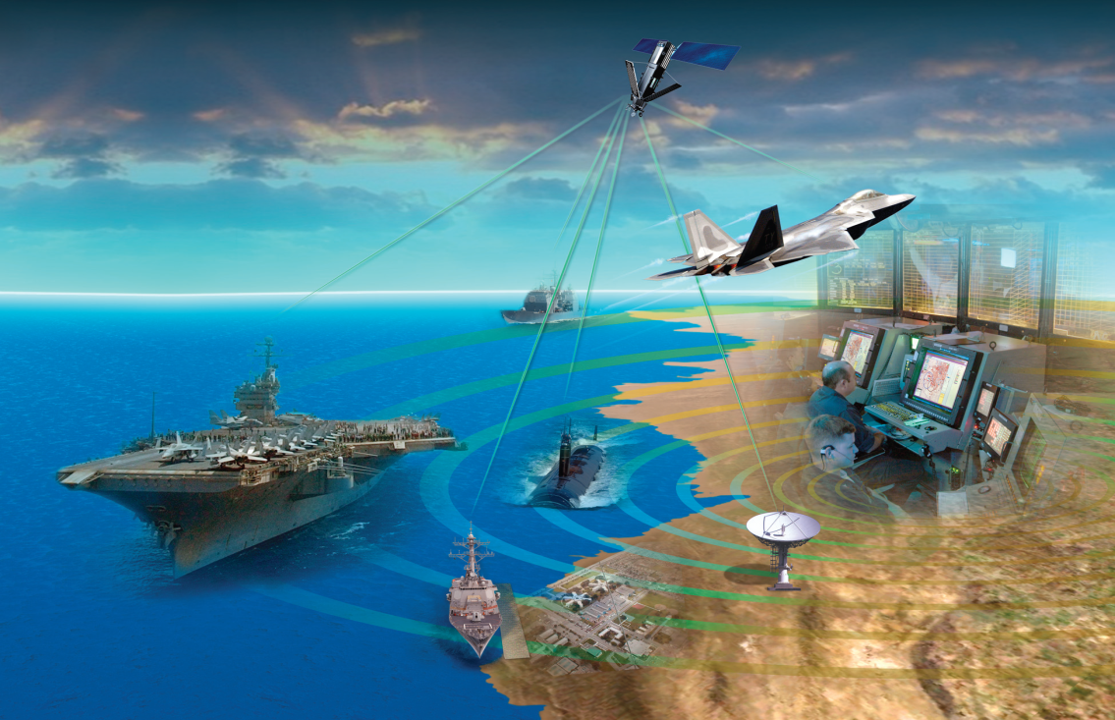
System Overview:
Slide 3
The Navy's Automated Digital Network System (ADNS) provides a means for ships to centralize and automate the operation of multiple independent radio communications systems into an efficient communications network.

Slide 4
Design Team Process: Did the design team follow its own process?
Slide 4
Based on an inspection and mapping of the ADNS Master Schedule contained in the ADNS Increment III Critical Design Review dated 7 MAR 2007 to the ADNS Systems Engineering Plan (version 3.0) dated SEP 2008 and corroborated by the CDRL Status Report, we conclude that design team followed its own process.

Slide 5
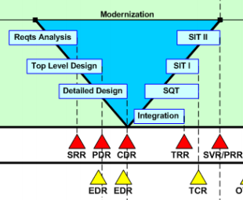
Design Team Process: Did the design team follow its own process?
Slide 5
Notes:
The basic development process follows the classic “V” model.
The specified process begins with requirements analysis and a system requirements review (SRR) followed by top-level design and preliminary design review (PDR), detained design and critical design review (CDR), integration and test readiness review (TRR), software qualification test (SQT), and system integration tests (SIT I & II).

Slide 6
Design Team Process: Did the design team follow its own process?
Slide 6
Mapping this release schedule to the ADNS Master Schedule contained in the ADNS Increment III Critical Design Review reveals a high degree of adherence and correlation between the specified and executed processes.
Looking through the ADNS Master Schedule under Engineering we find the following activities:
Requirements analysis (e.g., lines 32, 43, & 54)
Various system design line items (e.g., lines 55 & 56 mechanical and electrical design)
Integration (e.g., line 74)
Software test report (e.g., line 75)
System integration and testing (e.g., line 110)
The CDRL Status report also corroborates the process with the following items:
Preliminary design review (0007-ADNS-A004-CM-PDR-001)
Critical design review (0007-ADNS-A005-CA-CDR-001)
Software test report (0007-ADNS-A007-STR-001)
Notes:
The high degree of adherence between the specified and executed processes demonstrates sufficiently that the design team followed its own process.

Slide 7
Operational Concepts / Boundary Definitions: Were concepts of operations used to define boundaries and how the users intend to use the system in their domain?
Slide 7
…

Slide 8
Relationships between Functions & Elements: Is the relation between system functions and physical elements adequate?
Slide 8
…

Slide 9
Interface Descriptions – Logically & Physically Are interfaces described logically (functionally) and physically?
Slide 9
…

Slide 10
Roles (People-ware vs. Hardware & Software Is the role of people-ware vs. hardware & software described effectively?
Slide 10
…

Slide 11
Application of Architectural Framework If a framework was used for the architecture description, was it applied correctly?
Slide 11

Slide 12
Architecture Effectiveness Does the architecture do its job – bridge the sometimes immeasurable gap between stakeholders and detailed designers?
Slide 12

Slide 13
Recommendations:
Slide 13
…

Slide 14
Re-architecting Weak Aspects Can you re-architect those aspects that are weak?
Slide 14
…

Slide 15
Significant Changes since IPR1:
Slide 15

